Slide 1


Dr. N.G.P. INSTITUTE OF TECHNOLOGY
Coimbatore - 48
(An Autonomous Institution)
(Approved by AICTE, New Delhi & Affiliated to Anna University, Chennai
Recognized by UGC & Accredited by NAAC A+ and NBA (CSE, BME, EEE, ECE and Mech) Dr.N.G.P. Nagar, Kalapatti Main Rd, Coimbatore, Tamil Nadu 641048
Ph No: 0422 - 236 9105, Fax: 04222369106, E-mail: info@drngpit.ac.in
DEPARTMENT OF INFORMATION TECHNOLOGY
22UIT404- MINI PROJECT-I
CardioCare: Machine Learning for Health Care
Guided By
Dr.B.HEMALATHA
ASP/IT
Team Members
MADHU MITHA S (710723205037)
PREETHA J (710723205045)
SUJIKA S (710723205058)
THIRUNAAVUKKARASU S (710723205060)
BAARGAVAN A (710723205302)

Slide 2
OUTLINE
Introduction
Objective of the project
Literature Survey
Scope of the project
Proposed Methodology/ Techniques/Algorithms
List of Modules
Hardware & Software Specifications
Conclusion
References

Slide 3
INTRODUCTION
According to the WHO, heart disease is a major cause of death worldwide, accounting for 20.5 million deaths each year.
The project aims to develop a machine learning model to predict heart disease risk using patient variables like age, cholesterol, and lifestyle, improving predictive skills, prompt interventions, and individualized treatment plans.

Slide 4
OBJECTIVE OF THE PROJECT (Problem Statement)
Heart disease is a major global health concern, causing significant morbidity and mortality. Conventional diagnostic techniques frequently fails to identify at-risk patients in the early stages in an accurate manner
This model aims to improve predictive skills, allowing for prompt interventions and individualized treatment plans, ultimately improving patient outcomes and decreasing the load on healthcare systems.

Slide 5
LITERATURE SURVEY
S.No. | Title of the Paper | Author Details | Publication & Year | Remarks
01. | Heart Disease Prediction Using Hybrid Machine Learning | Ahmed, Mohammed and Idress Husien | Journal of Robotics and Control (JRC) 5, no. 3 & 2024 | The project improves heart disease prediction accuracy by integrating multiple machine learning models, but faces challenges in data quality, model complexity, and continuous validation across diverse populations
02. | Heart Attack Prediction using Machine Learning Techniques | Mall, Shubham | International Conference on Advance Computing and Innovative Technologies in Engineering & 2024 | The heart disease prediction system, utilizing health indicators for early detection, faces challenges in data quality, privacy, and model interpretability, necessitating clinical validation and ethical considerations.
03. | Enhancing Heart Attack Prediction with Machine Learning | Alshraideh, Mohammad, Najwan Alshraideh, Abedalrahman Alshraideh, Yara Alkayed, Yasmin Al Trabsheh, and Bahaaldeen Alshraideh | Applied Computational Intelligence and Soft Computing & 2024 | The system, which uses PSO for feature selection, achieves high prediction accuracy of 94.3%, but its specific dataset and computational complexity may limit its generalizability and efficiency.

Slide 6
LITERATURE SURVEY
04. | Effective feature engineering technique for heart disease prediction with machine learning | Babu, Ch Kiran, M. Iswarya, R. Manikanta Kumar, And M. Pavan Sai. | Journal of Nonlinear Analysis and Optimization & 2024 | The project enhances early heart failure detection using innovative feature engineering and machine learning techniques, but its specific feature selection methods and dataset quality may limit its applicability.
05. | Cardiac disease risk prediction using machine learning algorithms | Stonier,Albert Alexander, Rakesh Krishna Gorantla, and K. Manoj. | Healthcare Technology Letters & 2024 | The system enhances early heart attack detection with 88.52% accuracy, but its high-quality data reliance and Random Forest model complexity may limit its practical applicability.

Slide 7
SCOPE OF THE PROJECT
The project aims to develop a machine learning system for predicting heart disease using the Cleveland heart disease dataset. The key objective is to enhance diagnostic accuracy by applying the Jellyfish optimization algorithm for effective feature selection, identifying the most relevant patient data.
A Support Vector Machine (SVM) classifier will be used for classification. By leveraging swarm intelligence through Jellyfish optimization, the project intends to simplify the dataset, enhancing model performance and computational efficiency.
The system will deliver accurate predictions, facilitating early diagnosis and improved medical decision-making. Furthermore, it will compare its results against other machine learning techniques to validate its effectiveness in real-world applications.

Slide 8
PROPOSED METHODOLOGY/TECHNIQUES/ALGORITHMS
Problem Description
Heart disease is one of the killer diseases around the world, and most of the said cases are significantly influenced by age, cholesterol, and just plain lifestyle. This project shall attempt to design a machine learning model to forecast the chances of heart disease based on health information provided by the users.

Slide 9
PROPOSED METHODOLOGY/TECHNIQUES/ALGORITHMS
Hybrid Approaches:
Combine the Jellyfish algorithm with other optimization techniques (e.g., Genetic Algorithms, Particle Swarm Optimization) to enhance exploration and exploitation capabilities.
Adaptive Parameter Tuning:
Implement adaptive mechanisms that adjust parameters dynamically based on the progress of the optimization process.
Parallel Processing:
Utilize parallel computing to distribute the workload, reducing computation time and improving scalability.

Slide 10
PROPOSED METHODOLOGY/TECHNIQUES/ALGORITHMS
Multi-Start Strategy Verification:
Run the algorithm multiple times with different initial positions to reduce the likelihood of getting stuck in local optima.
Incorporating Storage Efficiency:
Introduce memory mechanisms that retain information about previously explored solutions to guide future searches.
Benchmarking and Testing:
Conduct thorough benchmarking against standard optimization problems to identify weaknesses and iteratively refine the algorith

Slide 11
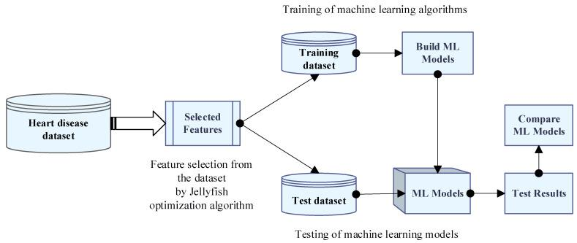
PROPOSED METHODOLOGY/TECHNIQUES/ALGORITHMS

Slide 12
LIST OF MODULES
Data Collection & Feature Extraction
Machine Learning Module
Front End (User Interface ) Module

Slide 13
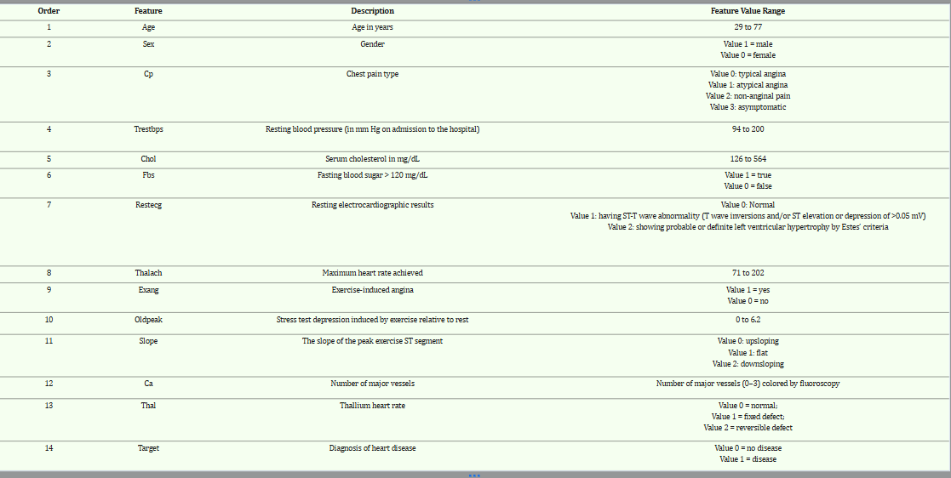
LIST OF MODULES
Data Collection & Feature Extraction:

Slide 14
LIST OF MODULES
Machine Learning Module :
Algorithms Used :
Jellyfish Optimization Algorithm (JOA)
Artificial Neural Networks (ANN)
Decision Tree (DT)
Adaboost (Adaptive Boosting)
Support Vector Machine (SVM)

Slide 15
LIST OF MODULES
Front End (User Interface ) Module
Simple User Interface
It is Responsive for smartphones and wide screens
User friendly Navigation
Resulting the Prediction

Slide 16
HARDWARE AND SOFTWARE SPECIFICATION
Hardware Specifications
1. CPU: intel core i3
2. RAM: 8 GB
3. Storage: 256 GB
Software Specifications
1. OS: Windows.
2. Languages: Python .
3. Libraries:
ML: Scikit-learn, XGBoost.
DL: TensorFlow, PyTorch.
Data: Pandas, NumPy.
4. Development Tools: Jupyter Notebook, VS Code.
5. Version Control: Git, GitHub.
6. Cloud Options: Google Colab.

Slide 17
CONCLUSION
The project aims to create a user-friendly platform that detects and predicts heart diseases based on a patient's medical information. It uses an algorithm to extract features, reduce errors, save time, and prevent heart disease impact. Data pre-processing is used for efficient use of annotated data samples.

Slide 18
REFERENCES ( Journal & Conference Papers/ Patent / Website in IEEE Format )
Journal/Conference (Must be in Chicago Format)
[1] Ahmed, Mohammed, and Idress Husien. "Heart Disease Prediction Using Hybrid Machine Learning: A Brief Review." Journal of Robotics and Control (JRC) 5, no. 3 (2024): 884-892.
[2] Mall, Shubham. "Heart Attack Prediction using Machine Learning Techniques." In 2024 4th International Conference on Advance Computing and Innovative Technologies in Engineering (ICACITE), pp. 1778-1783. IEEE, 2024.
[3] Alshraideh, Mohammad, Najwan Alshraideh, Abedalrahman Alshraideh, Yara Alkayed, Yasmin Al Trabsheh, and Bahaaldeen Alshraideh. "Enhancing heart attack prediction with machine learning: A study at jordan university hospital." Applied Computational Intelligence and Soft Computing 2024, no. 1 (2024): 5080332.
[4] BABU, CH KIRAN, M. ISWARYA, R. MANIKANTA KUMAR, and M. PAVAN SAI. "Effective feature engineering technique for heart disease prediction with machine learning." Journal of Nonlinear Analysis and Optimization 15, no. 1 (2024).
[5] Stonier, Albert Alexander, Rakesh Krishna Gorantla, and K. Manoj. "Cardiac disease risk prediction using machine learning algorithms." Healthcare Technology Letters 11, no. 4 (2024): 213-217.

